Slide 1
Analyzing the Reported Prevalence of Heart Disease among United States Adults : Trends from the National Center for Health Statistics Database
Blessing Itua
Annotto Bay Hospital, St. Mary, Jamaica

Slide 2
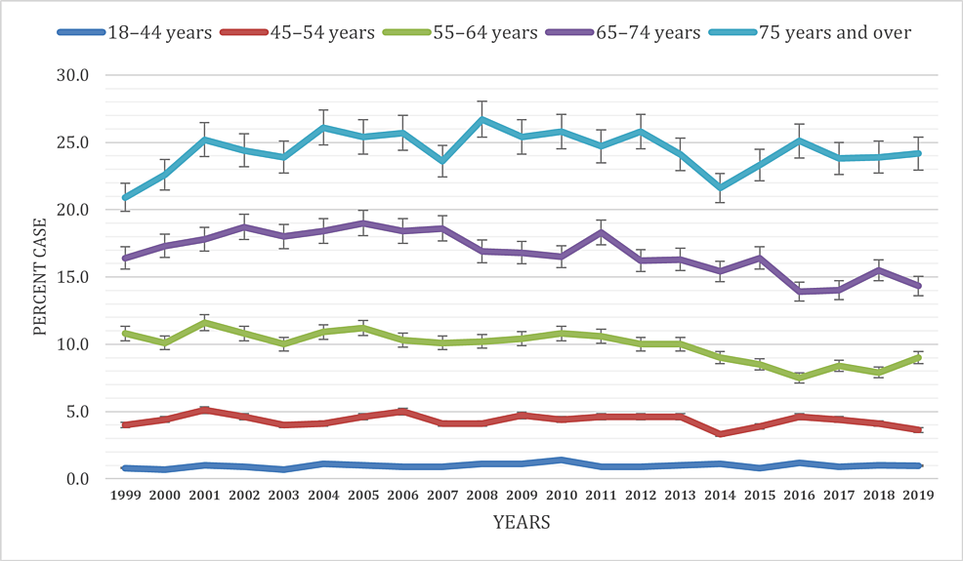
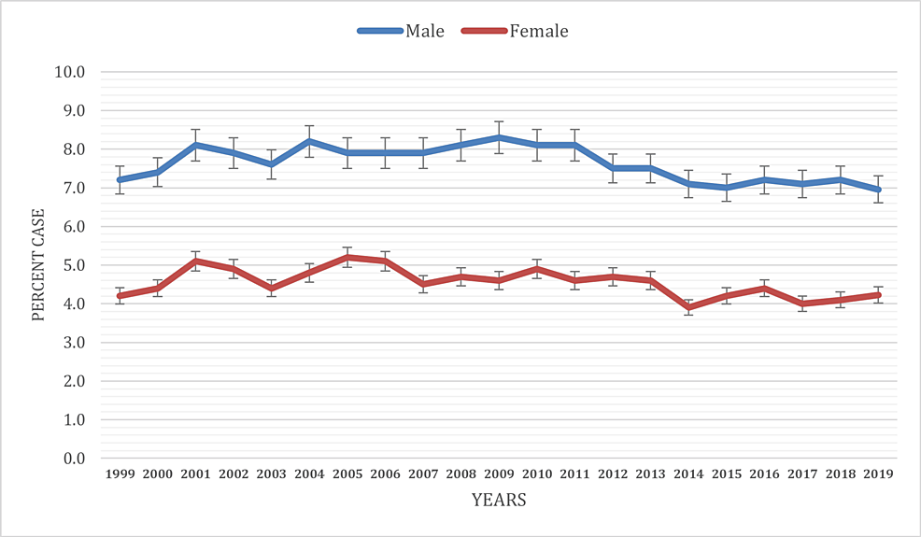
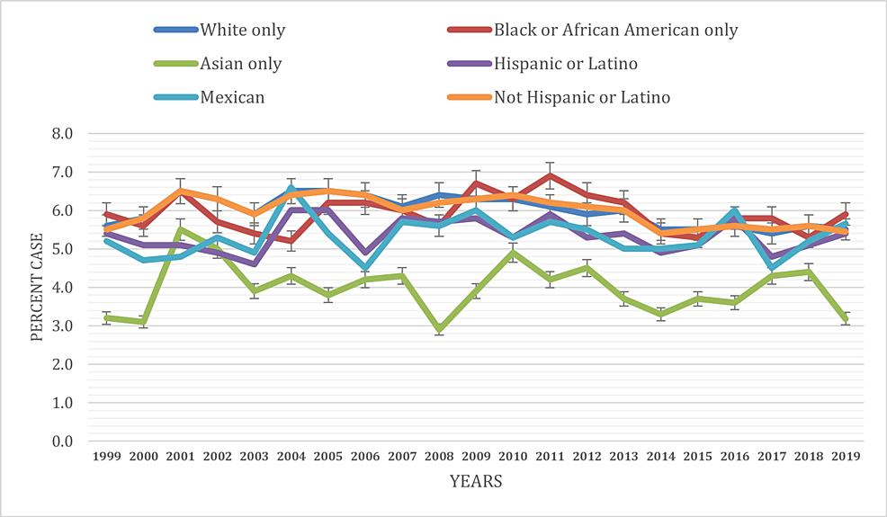
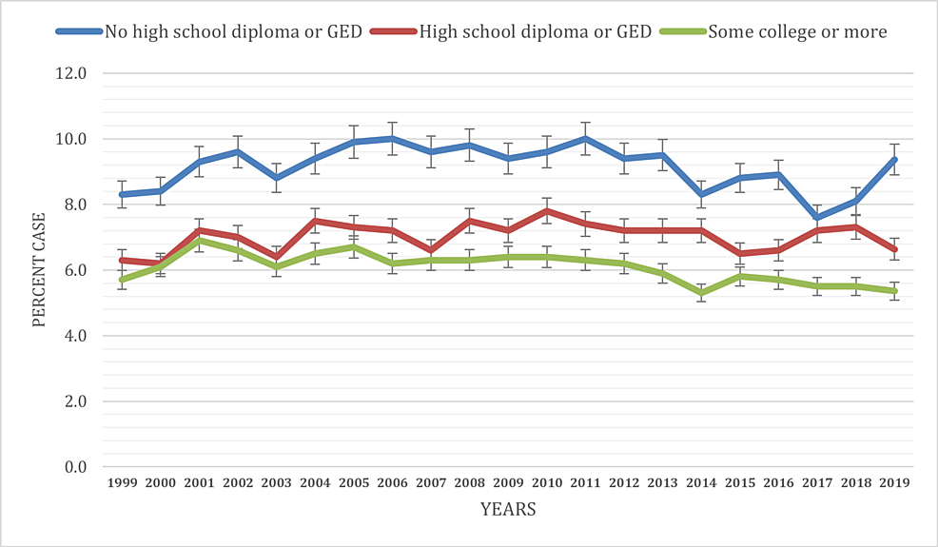
Co-authorship:¹Oluwafeyi Adedoyin MD; ²Seye A Olaniyi MBChB; ³Wendy Miranda MD; ⁴Omolola
R Ajekigbe MBBS; ⁵Ifelunwa M Osanakpo MD, ⁶Ogbodo T. Charles MBBS; ⁷Linda A. Mbah MD; ⁸Adaobi E. Atueyi MD; ⁹Joseph O. Adewale MBBS; ¹⁰Blessing Itua MD; ¹¹Chidinma J. Kanu MD; ¹²Chiadikobi A Okwu MBBS; *¹³Okelue Edwards Okobi MD, MS.
Objective:
This study aims to analyze the reported prevalence of heart disease among united states adults.
Methods:
A thorough analysis of the national center of health and statistics database was done to examine socioeconomic and demographic variables. the outcome was summarized using aggregate data from 1999-2019. one -way analysis of variance was used for statistical analysis
Results
The age-adjusted average reported heart disease prevalence for individuals aged 18 and over from 1999 to 2019 was 5.9%, fluctuating. Within the 18-44 age group, prevalence started at 1.0% and increased notably across subsequent age brackets: 45-54 (4.3%), 55-64 (9.9%), 65-74 (16.8%), and 75 and older (24.4%).
Adult men consistently had a higher prevalence (7.6%) than women (4.5%). Prevalence varied among racial groups, with the highest in American Indian or Alaska Native-only individuals (12.4%).
Socioeconomic variables illustrated a robust association between lower educational attainment, poverty, and increased heart disease prevalence. Geographic and metropolitan status analyses unveiled significant regional and residential disparities in reported heart disease prevalence.
Education-level analysis revealed a higher prevalence for lower education (9.1%) and a lower prevalence for higher education (6.1%). Significant differences were observed in each category (p < 0.001).

